Slide 1
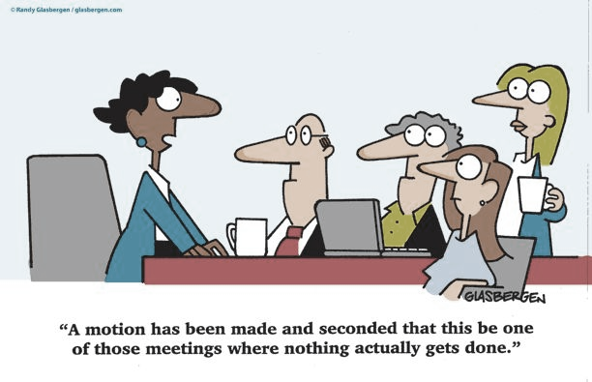
Essential elements: Professionalism
A presentation by Tu Nguyen and Jurgen Xhafaj

Slide 2

Becoming a mathematics teacher: the role of professional identity
12:15-12:20
Regarding the article from Akkoç and Yeşildere,
what was it about? What does the research consist of?
What is the impact of past learning experiences when it comes to teaching?

Slide 3
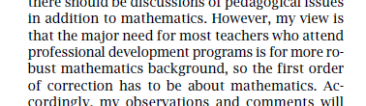
Professional Development of Mathematics Teachers
12:20-12:25
No extended lecturing.
Keep the mathematics simple and relevant to K–12
There should be grade-level separation.
There should be year-round follow-up programs to monitor the teachers’ progress.
Teachers should be paid for participating in professional development.
Now please start working on your worksheet.

Slide 4
How would you define professionalism in the field of teaching mathematics?
12:35-12:40
Collaboration (inside and outside the institution)
Development
Showcasing teaching methods
Research in one’s field
Coaching (we are always learning)
Reflection on our work

Slide 5
how do we get into the habit of becoming a professional at what we do?
12:40-12:45
1- Embrace the fact that we are lifelong learners and doers of mathematics.
2- We are responsible not only for covering the material. We also carry a responsibility for students’ mathematics learning.
3- While times and systems change, one thing remains true: the importance of collaboration and exchanging ideas.
4- There is no such a thing as an innate talent to teach.
5- Participating in professional learning communities.

Slide 6
What are some possible obstacles on the way to professionalism? What are their consequences?
12:45-12:50
Professional isolation from other teachers
→inconsistences in practice, which create inequities in student learning
Lack of time
→Irregular meetings are not effective in promoting sustained professional development
The current structure of professional development
→Currently, it has limited value and little impact on pedagogical knowledge

Slide 7
Areas where we can promote growth of mathematics teachers
12:50-12:55
Teachers’ mathematical knowledge and their capacity to use it in practice
Teachers’ capacity to notice, analyze, and respond to students’ thinking
Teachers’ beliefs and dispositions that foster their continued learning
Teachers’ collegial relationships and learning structures that can support and sustain their learning
Now please start working on your worksheet as group.

Slide 8
Productive Beliefs in professionalism
12:55-1:00
Teachers are collectively responsible for improving their own professional knowledge base, as well as students’ learning.
Collaboration is key to success, in and outside the institution.
Everybody can benefit from regularly scheduled meetings with coaches who have more experience.
Being a teacher comes with practice and persistence, it is not an innate ability.
Planning lessons ahead of time helps a teacher’s professional development.

Slide 9
What would an ideal professional development program look like?
1:00-1:05
Substantial time investment over a sustained period (i.e., six months or more)
Systemic support for teachers’ learning (i.e., administrative support and coherence with other school initiatives)
Opportunities for teachers to participate in active learning
Opportunities for teachers to study the mathematics underlying the curriculum that they teach

Slide 10
Thank you for your participation!

Slide 11
Overcoming the obstacles ==quotes==
Schmoker (2006) noted that “professional learning communities have emerged as arguably the best, most agreed-upon means by which to continuously improve instruction and student performance … [T]he concurrence of the research community on this approach is quite remarkable” (P. 106).
“Teachers’ co-planning of lesson provides one of the greatest opportunities for making a positive difference on students learning” (Hattie 2012; Morris, Hiebert, and Spitzer 2009).

Slide 12
Collaborating on instruction == ideas ==
Professional learning communities must focus on issues related to pedagogy and student achievement and explore so the teachers can work together towards common goals.
To improve instruction and ensure the mathematical success of all students, this practice of limited and isolated instructional planning must be eliminated and replaced with a practice of allocating time for collaborative planning.
Effective mathematics teachers not only collaborate but also focus their collaborative efforts on improving instruction and student learning through the co-planning of lessons.
To improve instructional practice, teachers need to devote more time not only to collaborative planning but also intentional and structured reflection.

Slide 13
COACHING SUPPORT
Collaboration with peers is not enough.
Coaching is a critical component in supporting the implementation of effective teaching practices.
A mathematics instructional coach or specialist “is an individual who is well versed in mathematics content and pedagogy and who works directly with classroom teachers to improve student learning in mathematics” (Hull, Balka, and Harbin Miles 2009, P. 3)

